Slide 1
Summer Months Strategy Portfolio Analysis
L. Gallez
D. Walker
J. Rodriguez
A. Osterholt
November 29, 2018

Slide 2
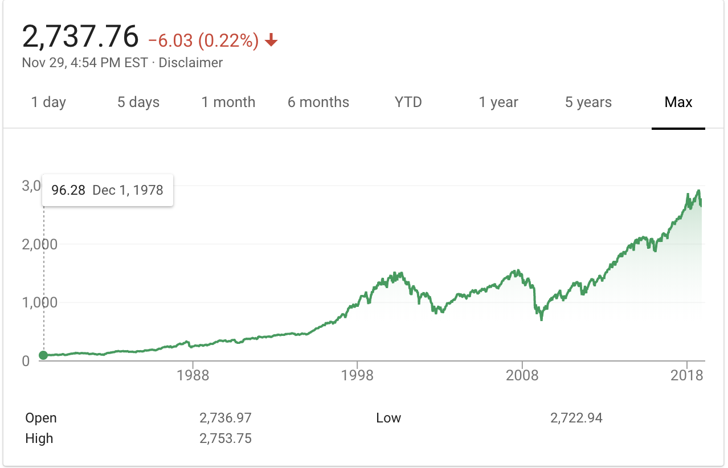
S&P 500 Market Trend
Can you really buy low and sell high?

Slide 3
How Should I Invest?
Is there a market strategy out there that I can:
Understand
Create Alpha
Be repeatable
Limit my risk

Slide 4
I need data
Diverse market with large trendable data sets: Monthly Open/Close Prices with Volume
Answer: Alpha Vantage (API)
20 years of data
Better answer: Yahoo Finance (CSV)
50+ years of monthly data

Slide 5
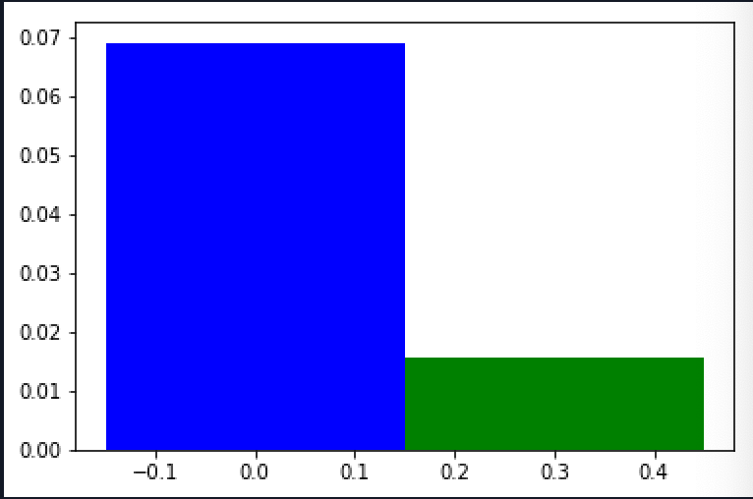
Seasonality of Returns: 1951 - 2018
Maybe it depends on the season...
Nov - Apr
May - Oct

Slide 6
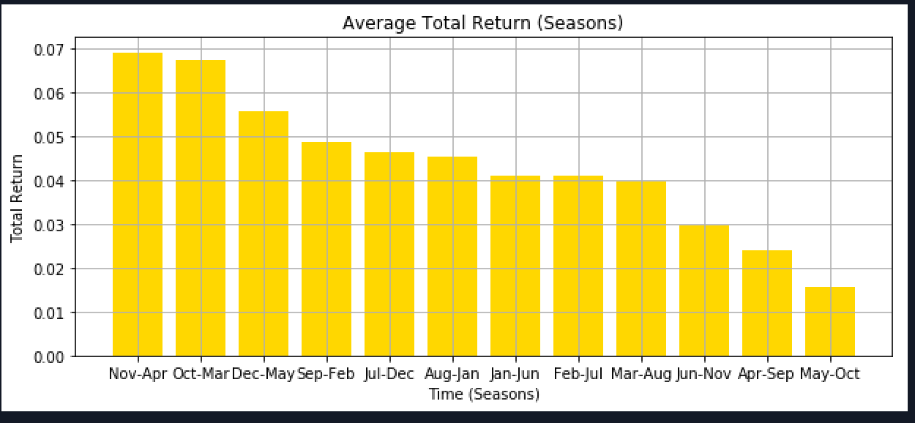
A Tale of Many Seasons
Average Total Return from 1951-2018: May - Oct

Slide 7
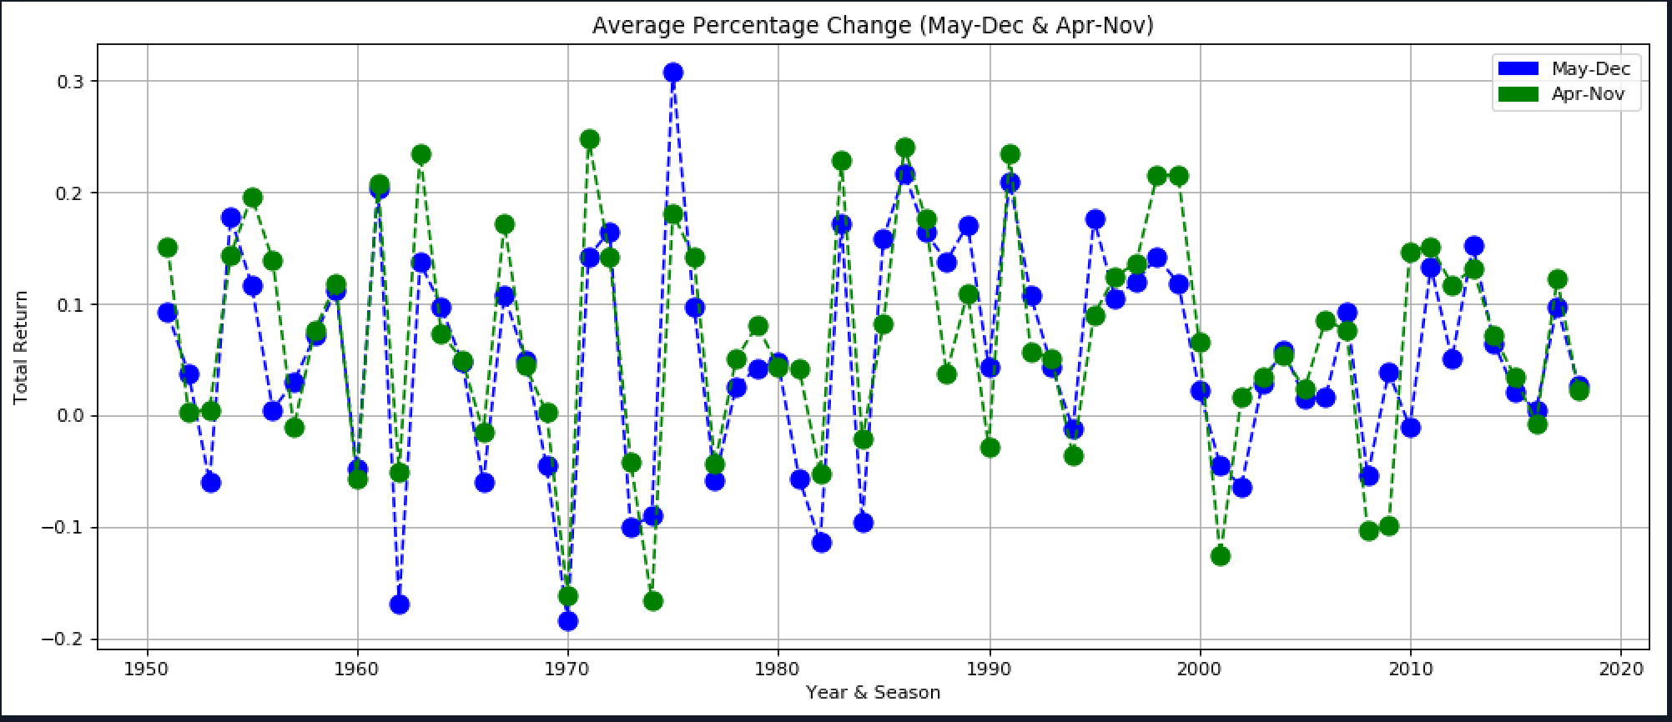
SEASONALITY: Six-Month Results by Over Time
Average Total Return from 1951-2018

Slide 8
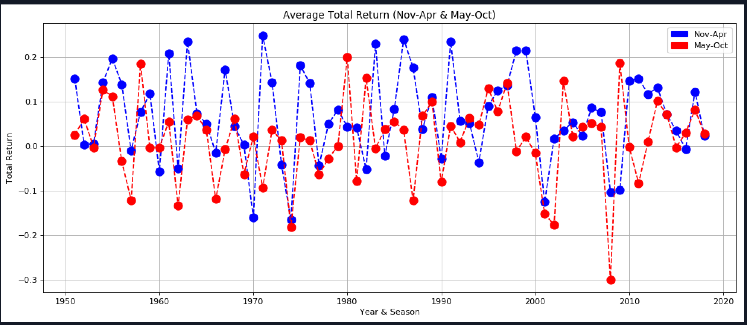
Highest Performing Months Compared to Lowest Performing
Average Total Return from 1951-2018

Slide 9
Seasonality Conclusions
Evidence of Seasonal Investing Benefits
Do not endorse any investing strategy without due diligence
May – Oct: Avg return 1.6%
Nov – Apr: 6.9%
Research is not clear what causes this strategy, but possible explanations are:
Vacation months lead to risk aversion
Optimism at the beginning of the year
Effect has been in place since 1950
More recent studies show that this effect in 108 countries from data as far back as 1693 (Jacobsen & Zhang, 2012)

Slide 10
Model Assumption
For the purpose of simplicity we are focusing only on the effects of time and not taking into account any other external factors such as:
S&P 500 chosen assumed to be diverse, in all years by market cap and industry
Stock splits do not dilute returns
Companies switching or being added to index has no effect (within S&P)
Dividend reinvesting is unaccounted for vs simple price appreciation
Opening Price of 1st day of ‘next month’ equals Closing Price of the last day of the ‘previous month’

